Slide 1
Study Environment, HDL, & Boolean Logic
Study Environment Discussion, Boolean Logic and Functions, Hardware Descriptive Language, Project 2 Overview

Slide 2





Course Staff Introductions

Slide 3
Project 1 Check-in
The specification says Project 1 will take 30-60 minutes
  Likely an underestimation
  It may be taking longer for you, and that’s okay
Seeing some GREAT questions and answers on Ed!
Your terminal setup will unlikely look the same as mine, and that’s okay
  Just ensure that the commands are correct
Double-check your submission on GitLab!
  Navigate to GitLab, open tags, and verify that the associated commit includes your expected changes

Slide 4
Lecture Outline
Study Environment Discussion
Boolean Logic and Functions
  Boolean Expressions, Circuit Diagrams, Truth Tables
  Boolean Function Synthesis Strategy
  The Foundational Gate: NAND
Hardware Descriptive Languages (HDL)
  HDL Syntax, And Gate Example
Project 2 Overview
  Xor Implementation Example in HDL

Slide 5
Study Environment Discussion
In groups of 3-4, discuss the following questions about study environments:
On a typical day, what does your study environment look like? Be specific!
What contributes to an effective study environment? Why?
  What changes can you make to introduce some of these factors?
What factors hinder a study environment from being effective? Why?
  What changes can you make to remove some of these factors?

Slide 6
Lecture Outline
Study Environment Discussion
Boolean Logic and Functions
  Boolean Expressions, Circuit Diagrams, Truth Tables
  Boolean Function Synthesis Strategy
  The Foundational Gate: NAND
Hardware Descriptive Languages (HDL)
  HDL Syntax, And Gate Example
Project 2 Overview
  Xor Implementation Example in HDL

Slide 7
Pre-lecture Reading Question: Which of the following statements is FALSE?
The Boolean Function Synthesis strategy works on every truth table
In CSE 390B, we will be asking you to write Boolean expressions that are simplified
The abstraction of voltages on a physical wire represents two values
A truth table lists every possible combination of inputs for a Boolean operation
We’re lost…

Slide 8


Boolean Values
A binary choice: True or False
Also known as a “low” signal (false, “off,” or 0) and a “high” signal (true, “on”, or 1)
“Off”
False
0
“On”
True
1

Slide 9



Boolean Operations
Use logical operations to combine Boolean values
  Truth table: A table that lists every possible set of inputs and the corresponding output of the operation
  Operations correspond to physical hardware gates
Examples:
A | B | F
0 | 0 | 0
0 | 1 | 0
1 | 0 | 0
1 | 1 | 1
A | B | F
0 | 0 | 0
0 | 1 | 1
1 | 0 | 1
1 | 1 | 1
A | F
0 | 1
1 | 0

Slide 10
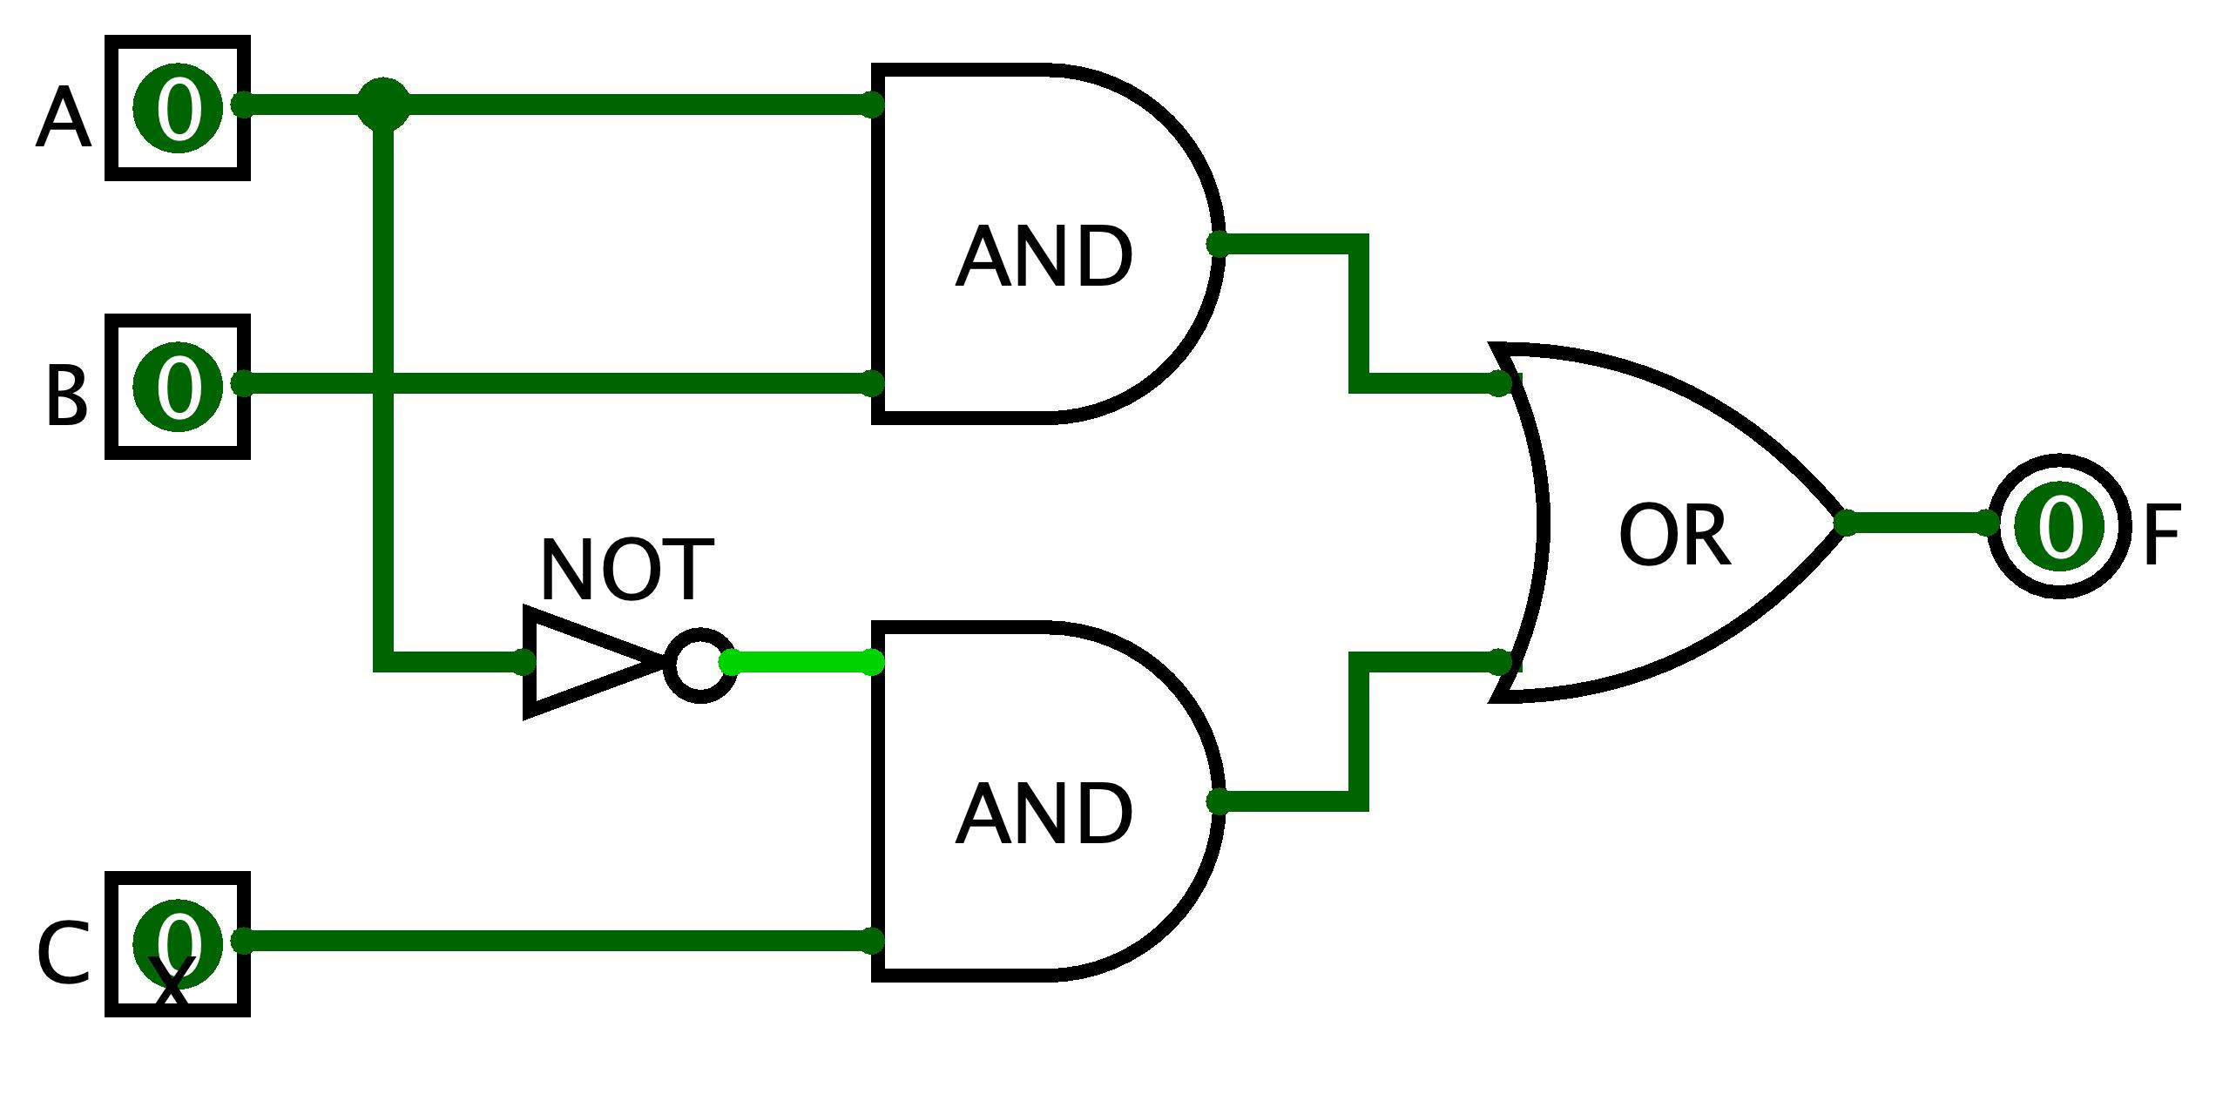
Boolean Operations
Combinations of Boolean inputs
Three ways to specify a Boolean function:
  Boolean expression: F = (A AND B) OR (NOT(A) AND C)
  Circuit diagram with logic gates:
  Truth table:
A | B | C | F
0 | 0 | 0 | 0
0 | 0 | 1 | 1
0 | 1 | 0 | 0
0 | 1 | 1 | 1
1 | 0 | 0 | 0
1 | 0 | 1 | 0
1 | 1 | 0 | 1
1 | 1 | 1 | 1

Slide 11
Boolean Expression → Truth Table
We know how to build a truth table from an expression
  Evaluate the Boolean expression on all possible inputs
F(A, B, C) = (A AND B) OR (NOT(A) AND C)
A | B | C | F
0 | 0 | 0
0 | 0 | 1
0 | 1 | 0
0 | 1 | 1
1 | 0 | 0
1 | 0 | 1
1 | 1 | 0
1 | 1 | 1

Slide 12
Boolean Expression → Truth Table
We know how to build a truth table from an expression
  Evaluate the Boolean expression on all possible inputs
F(A, B, C) = (A AND B) OR (NOT(A) AND C)
A | B | C | F
0 | 0 | 0 | 0
0 | 0 | 1 | 1
0 | 1 | 0 | 0
0 | 1 | 1 | 1
1 | 0 | 0 | 0
1 | 0 | 1 | 0
1 | 1 | 0 | 1
1 | 1 | 1 | 1

Slide 13
Boolean Expression ← Truth Table
But can we do it in reverse?
F(A, B, C) = ?
?
A | B | C | F
0 | 0 | 0 | 0
0 | 0 | 1 | 1
0 | 1 | 0 | 0
0 | 1 | 1 | 1
1 | 0 | 0 | 0
1 | 0 | 1 | 0
1 | 1 | 0 | 1
1 | 1 | 1 | 1

Slide 14
Boolean Expression ← Truth Table
We can describe a single row with AND and NOT
A | B | C | F
0 | 0 | 0 | 0
0 | 0 | 1 | 1
0 | 1 | 0 | 0
0 | 1 | 1 | 1
1 | 0 | 0 | 0
1 | 0 | 1 | 0
1 | 1 | 0 | 1
1 | 1 | 1 | 1

Slide 15
Boolean Expression ← Truth Table
We can describe a single row with AND and NOT
A | B | C | F
0 | 0 | 0 | 0
0 | 0 | 1 | 1 | NOT(A) AND NOT(B) AND C
0 | 1 | 0 | 0
0 | 1 | 1 | 1
1 | 0 | 0 | 0
1 | 0 | 1 | 0
1 | 1 | 0 | 1
1 | 1 | 1 | 1

Slide 16
Boolean Expression ← Truth Table
We can describe a single row with AND and NOT
A | B | C | F
0 | 0 | 0 | 0
0 | 0 | 1 | 1 | NOT(A) AND NOT(B) AND C
0 | 1 | 0 | 0
0 | 1 | 1 | 1 | NOT(A) AND B AND C
1 | 0 | 0 | 0
1 | 0 | 1 | 0
1 | 1 | 0 | 1
1 | 1 | 1 | 1

Slide 17
Boolean Expression ← Truth Table
We can describe a single row with AND and NOT
A | B | C | F
0 | 0 | 0 | 0
0 | 0 | 1 | 1 | NOT(A) AND NOT(B) AND C
0 | 1 | 0 | 0
0 | 1 | 1 | 1 | NOT(A) AND B AND C
1 | 0 | 0 | 0
1 | 0 | 1 | 0
1 | 1 | 0 | 1 | A AND B AND NOT C
1 | 1 | 1 | 1

Slide 18
Boolean Expression ← Truth Table
We can describe a single row with AND and NOT
A | B | C | F
0 | 0 | 0 | 0
0 | 0 | 1 | 1 | NOT(A) AND NOT(B) AND C
0 | 1 | 0 | 0
0 | 1 | 1 | 1 | NOT(A) AND B AND C
1 | 0 | 0 | 0
1 | 0 | 1 | 0
1 | 1 | 0 | 1 | A AND B AND NOT C
1 | 1 | 1 | 1 | A AND B AND C

Slide 19
Boolean Expression ← Truth Table
We can describe a single row with AND and NOT
F = NOT(A) AND NOT(B) AND C OR NOT(A) AND B AND C OR
A AND B AND NOT C OR A AND B AND C
A | B | C | F
0 | 0 | 0 | 0
0 | 0 | 1 | 1 | NOT(A) AND NOT(B) AND C
0 | 1 | 0 | 0
0 | 1 | 1 | 1 | NOT(A) AND B AND C
1 | 0 | 0 | 0
1 | 0 | 1 | 0
1 | 1 | 0 | 1 | A AND B AND NOT C
1 | 1 | 1 | 1 | A AND B AND C

Slide 20
Boolean Expression ← Truth Table
But can we do it in reverse?
  Yes, we can! The strategy we used is Boolean Function Synthesis
F(A, B, C) = (A AND B) OR (NOT(A) AND C)
✓
A | B | C | F
0 | 0 | 0 | 0
0 | 0 | 1 | 1
0 | 1 | 0 | 0
0 | 1 | 1 | 1
1 | 0 | 0 | 0
1 | 0 | 1 | 0
1 | 1 | 0 | 1
1 | 1 | 1 | 1

Slide 21


The Foundational Gate: Nand
It all starts with the NAND gate
NAND is short for “Not And”
  The same output as the AND gate, but every output bit is negated (flipped)
A | B | F
0 | 0 | 0
0 | 1 | 0
1 | 0 | 0
1 | 1 | 1
A | B | F
0 | 0 | 1
0 | 1 | 1
1 | 0 | 1
1 | 1 | 0

Slide 22
Building Gates From Nand
Recall the Boolean Function Synthesis strategy from today’s reading
  We saw how we can represent any truth table in terms of three gates: Not, And, Or
First, we can represent Not directly from Nand
  Not a = a Nand a
Then, we can represent And in terms of Not and Nand
  a And b = Not(a Nand b)
Represent Or in terms of Not and And
  Apply De Morgan’s Law
  a Or b = Not(Not(a) And Not(b)) [De Morgan’s Law]

Slide 23
Lecture Outline
Study Environment Discussion
Boolean Logic and Functions
  Boolean Expressions, Circuit Diagrams, Truth Tables
  Boolean Function Synthesis Strategy
  The Foundational Gate: NAND
Hardware Descriptive Languages (HDL)
  HDL Syntax, And Gate Example
Project 2 Overview
  Xor Implementation Example in HDL

Slide 24
Hardware Design Language (HDL)
HDL is a programming language to specify hardware components and how they’re connected
  Yet another way of writing a Boolean function
Many Hardware Design Languages are use today
  E.g., VHDL, Verilog, SystemVerilog
  In this course, we’ll use a simple HDL language called “HDL”
Unlike Java, HDL is a declarative language. This means…
  The order of statements (lines of code) doesn’t matter
  We are describing a physical system

Slide 25
Hardware Design Language (HDL)
Makeup of an HDL file
  File comment describes expected behavior
  IN names chip inputs, OUT names chip outputs
  PARTS specify the components that implement the chip
    For Project 2, this will mostly be specifying Boolean functions
/**
* And gate:
* out = 1 only if both a and b are 1
*/
CHIP And {
  IN a, b;
  OUT out;
  PARTS:
  // Put your code here:
  }

Slide 26
Reusing Components
You can use chips you have already implemented to implement subsequent chips
We give you one gate, Nand, to start out with
  Implication: Your entire computer is essentially built on Nand gates
We also give you some chips you can use without implementing
  See project specification for more details

Slide 27
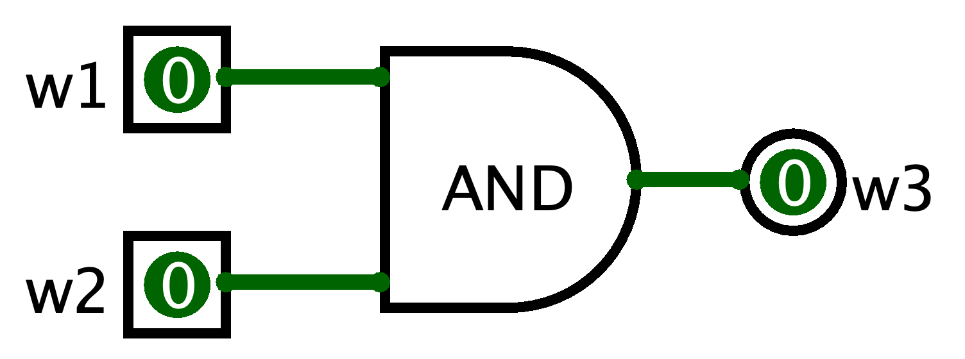
HDL Component Example: AND
The chip specification tells us the name of the input and output wires
Goal: Implement w1 AND w2
  HDL Syntax: And(a=w1, b=w2, out=w3);
  Equivalent circuit diagram:
CHIP And {
  IN a, b;
  OUT out;
  ...
  }

Slide 28
Multi-bit Buses in HDL
It can be useful to manipulate groups of wires
  Called a “bus” of wires
HDL provides array like syntax for manipulating buses
  And4 chip example:
/**
* Bit-wise And of two 4-bit inputs
*/
CHIP And4 {
IN a[4], b[4];
OUT out[4];
PARTS:
And (a=a[0], b=b[0], out=out[0]);
And (a=a[1], b=b[1], out=out[1]);
And (a=a[2], b=b[2], out=out[2]);
And (a=a[3], b=b[3], out=out[3]);
}

Slide 29
HDL Resources
HDL will feel unfamiliar at first, and that’s okay
Some resources for helping you navigate HDL (these are all linked under the Resources page on the course website
  HDL Survival guide
  Appendix A (HDL Spec)
  Chip Set Overview (to help you remember the inputs/outputs for various chips)
  Chapter readings

Slide 30
Five-minute Break!
Feel free to stand up, stretch, use the restroom, drink some water, review your notes, or ask questions
We’ll be back at:
Please sign up for your first 1:1 Student-TA meeting now if you have not already (signup sheet linked here)
Any song recommendations? Respond on Poll Everywhere at https://pollev.com/cse390b
Olmsted III, John. “The Mid-Lecture Break: When Less Is More.” Journal of Chemical Education (1999). https://pubs.acs.org/doi/abs/10.1021/ed076p525.

Slide 31
Lecture Outline
Study Environment Discussion
Boolean Logic and Functions
  Boolean Expressions, Circuit Diagrams, Truth Tables
  Boolean Function Synthesis Strategy
  The Foundational Gate: NAND
Hardware Descriptive Languages (HDL)
  HDL Syntax, And Gate Example
Project 2 Overview
  Xor Implementation Example in HDL

Slide 32
Project 2 Overview
Part I: Study Skills Inventory
  Self-assessing your skill level in various study practices and habits
Part II: Boolean Logic
  Clone your GitLab repository, write and test your code
Part III: Project 2 Reflection
  Reflect on your experience working through Project 2
Due next Thursday (4/7) at 11:59pm PDT

Slide 33
Project 2 Overview
Every logic gate in our computer can be implemented in terms of Nand
We provide you only Nand to start Project 2
You will build other basic gates (Not, And, etc.) in terms of Nand and then build increasingly complex gates
Culminates to building a computer that, at its core, is entirely based on Nand gates

Slide 34
Project 2 Example: Xor
Let’s walk through an example of a gate that you will be implementing in Project 2
Together, we’ll implement the Xor gate
/**
* Xor gate:
* out = not(a == b)
*/
CHIP Xor {
  IN a, b;
  OUT out;
  PARTS:
  // Put your code here:
  }

Slide 35
Project 2 Example: Xor
Plan of action:
  Step 1: Create the logic operation’s truth table
  Step 2: Use truth table to generate a Boolean function using strategies we’ve learned, such as the Boolean Function Synthesis
  Step 3: Convert Boolean function to HDL
/**
* Xor gate:
* out = not(a == b)
*/
CHIP Xor {
  IN a, b;
  OUT out;
  PARTS:
  // Put your code here:
  }

Slide 36

Project 2 Example: Xor
Step 1: Create the truth table for Xor
  Interpret the specification: F = NOT(A == B)
A | B | F
0 | 0 | 0
0 | 1 | 1
1 | 0 | 1
1 | 1 | 0

Slide 37

Project 2 Example: Xor
Step 2: Use truth table to generate a Boolean function
  Let’s use the Boolean Function Synthesis strategy from the reading
A | B | F
0 | 0 | 0 | (Row 1)
0 | 1 | 1 | (Row 2)
1 | 0 | 1 | (Row 3)
1 | 1 | 0 | (Row 4)

Slide 38
Project 2 Example: Xor
Step 2: Use truth table to generate a Boolean function
  Let’s use the Boolean Function Synthesis strategy from the reading
  Row 2 = NOT(A) AND B
A | B | F
0 | 0 | 0 | (Row 1)
0 | 1 | 1 | (Row 2)
1 | 0 | 1 | (Row 3)
1 | 1 | 0 | (Row 4)

Slide 39
Project 2 Example: Xor
Step 2: Use truth table to generate a Boolean function
  Let’s use the Boolean Function Synthesis strategy from the reading
  Row 2 = NOT(A) AND B
  Row 3 = A AND NOT(B)
  F = ?
A | B | F
0 | 0 | 0 | (Row 1)
0 | 1 | 1 | (Row 2)
1 | 0 | 1 | (Row 3)
1 | 1 | 0 | (Row 4)

Slide 40
What is the unsimplified Boolean expression result from performing Boolean function synthesis on F = A XOR B?
  (A AND NOT(B)) AND (NOT(A) AND B)
  (NOT(A) AND B) AND (A AND B)
  (A AND B) OR (NOT(A) AND NOT(B))
  (NOT(A) AND B) OR (A AND NOT(B))
  We’re lost…
A | B | F = A XOR B
0 | 0 | 0 | (Row 1)
0 | 1 | 1 | (Row 2)
1 | 0 | 1 | (Row 3)
1 | 1 | 0 | (Row 4)
  Row 2 = NOT(A) AND B
  Row 3 = A AND NOT(B)

Slide 41
Project 2 Example: Xor
Step 2: Use truth table to generate a Boolean function
  Let’s use the Boolean function synthesis strategy from the reading
  Row 2 = NOT(A) AND B
  Row 3 = A AND NOT(B)
  A XOR B = Row 2 OR Row 3
= (NOT(A) AND B) OR (A AND NOT(B))
A | B | F
0 | 0 | 0 | (Row 1)
0 | 1 | 1 | (Row 2)
1 | 0 | 1 | (Row 3)
1 | 1 | 0 | (Row 4)

Slide 42
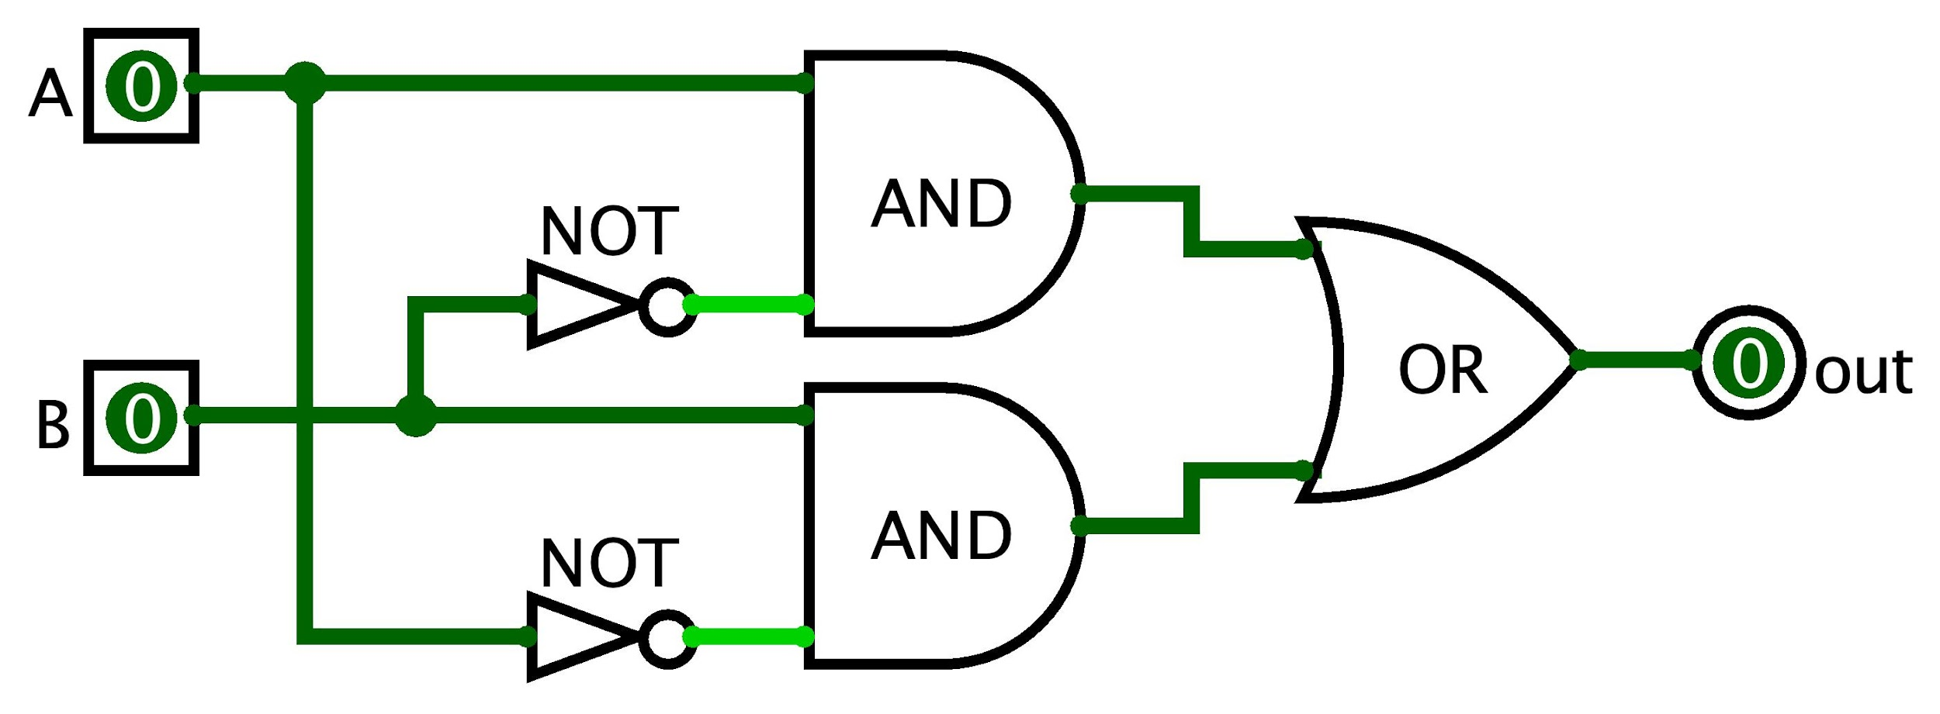
Project 2 Example: Xor
May be helpful to convert a Boolean expression to a circuit diagram
A XOR B = (NOT(A) AND B) OR (A AND NOT(B))

Slide 43
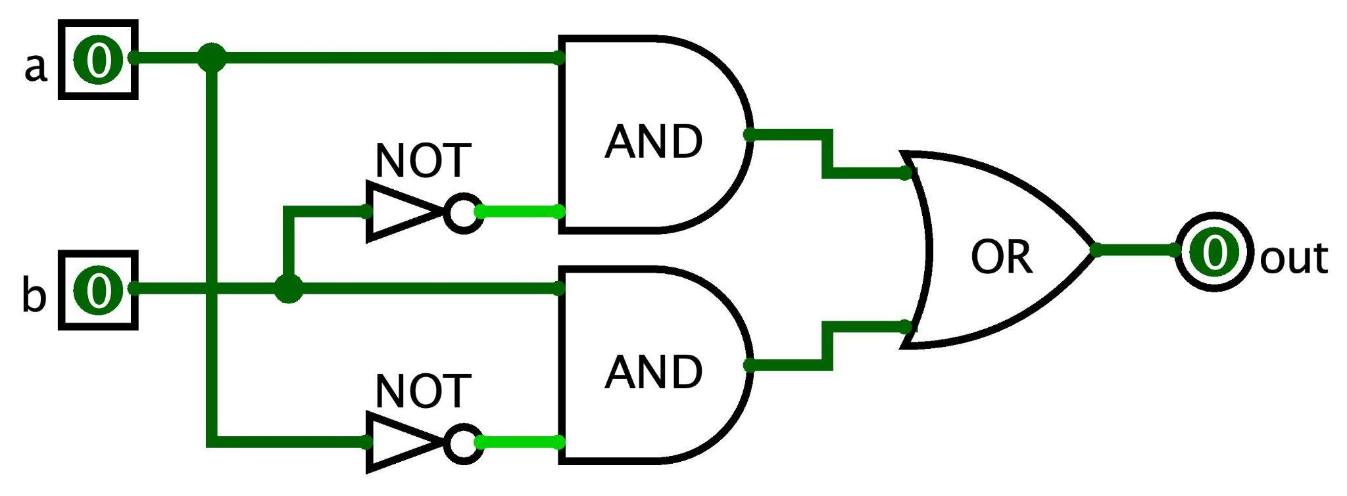
Project 2 Example: Xor
Step 3: Convert Boolean function to HDL syntax
  A XOR B = (NOT(A) AND B) OR (A AND NOT(B))
  Assumes Not, And, and Or are already implemented
  Note the use of intermediary wires: nota, notb, x, and y
CHIP Xor {
  IN a, b;
  OUT out;
  PARTS:
  Not (in=a, out=nota);
  Not (in=b, out=notb);
  And (a=a, b=notb, out=x);
  And (a=nota, b=b, out=y);
  Or (a=x, b=y, out=out);
  }

Slide 44
Project 2 Demonstration
Work through the tools you will use in Project 2
Today’s goal: Tinker with all the tools for Project 2
Stretch goal: Implement the first gate in Project 2, Not
  Interacting with the tools and implementing the gates will help you become familiar with the interface and address any confusion

Slide 45
Project 2 Group Work
Group time to work on the first gate, Not, in Project 2
Complete the following tasks in groups:
  Read the Overview section of the specification
  Estimate how much time you think it will take to finish Project 2
  Clone your GitLab repository (instructions in Project 1)
  Open the HardwareSimulator (see instructions in the Tools section of the specification)
  Dive into it! Implement and test the Not gate

Slide 46
Wrapping Up
Exciting topics for Week 2!
  Metacognitive Subject: Time Management ⏱
  Technical Subject: Boolean Arithmetic & ALU
Project Reminders:
  Project 1 due tonight (Thursday, 3/31) at 11:59pm PDT
  Projects will generally be graded two days after the due date
  Project 2 (Study Skills Inventory & Boolean Logic) released, due next Thursday (4/7) at 11:59pm PDT
First Student-TA meetings starting this week! 🎉
  If you haven’t yet, sign up for your first meeting in the signup spreadsheet
  Your TA will be in contact with you about the first meeting

